Slide 1
Introduction to Ansible
Automating IT with Ansible
Abir Bandyopadhyay, Lead Engineer, Prodapt

Slide 2
Agenda
Day-1
Introduction to Ansible – Why, What and How.
How to Install Ansible, prerequisites, password-less authentication and Ansible inventory.
Ansible adhoc commands.
How to write yaml files and Ansible playbook.
Day-2
Deep dive into Ansible playbook.
Ansible roles and Ansible Galaxy.
Deployments using Ansible

Slide 3
Introduction to Ansible – Why, What and How.
Definition of Ansible: Ansible is an open-source automation tool used for configuration management, application deployment, and task automation.
Brief History: Initially released in 2012, Ansible was created by Michael DeHaan and is now maintained by Red Hat. It has evolved significantly, becoming one of the leading tools in the DevOps space.
Key Features:
Agentless: No agents need to be installed on managed nodes; it uses SSH for communication.
YAML: Playbooks are written in YAML, which is easy to read and write.
Idempotency: Ensures that operations can be repeated without changing the system's state after the desired state is achieved.

Slide 4
Why Use Ansible?
Benefits:
Simplicity: Easy to learn and use, especially with its human-readable YAML syntax.
Scalability: Can manage thousands of nodes with minimal setup.
Community Support: A large community that contributes to modules, roles, and documentation.
Use Cases:
Configuration Management: Automating the setup of systems.
Application Deployment: Streamlining the deployment process of applications.

Slide 5
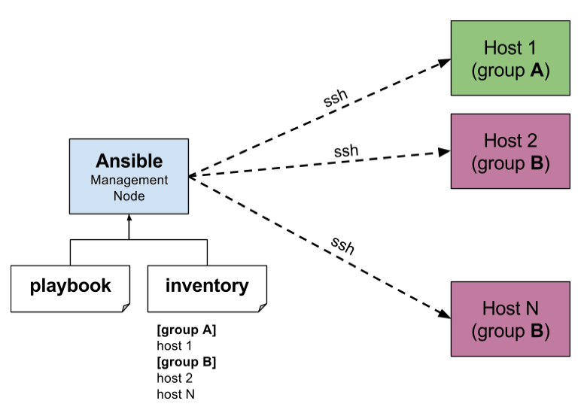
Ansible Architecture
Components:
Control Node: The machine where Ansible is installed and run.
Managed Nodes: The target machines being managed by Ansible.
Inventory: A file listing managed nodes.
Modules: Reusable units of code that perform specific tasks.

Slide 6

Installation
Prerequisites:
- Ensure Python is installed on the control node.
- SSH access to the managed nodes.
Installation Steps:
- For Linux: Use package managers like apt or yum.
- For Windows: Use Windows Subsystem for Linux (WSL) or native installation methods.

Slide 7
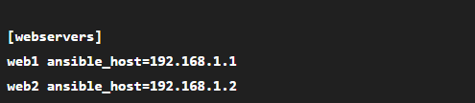
Ansible Inventory
What is an inventory?
It’s a file that lists the hosts managed by Ansible.
Static vs. Dynamic Inventory:
Static inventories are defined in files, while dynamic inventories can pull from external sources (e.g., cloud services).

Slide 8
Ansible adhoc commands
Ad hoc tasks can be used to reboot servers, copy files, manage packages and users, and much more. You can use any Ansible module in an ad hoc task. ad hoc tasks, like playbooks, use a declarative model,
calculating and executing the actions required to reach a specified final state.
They achieve a form of idempotence by checking the current state before they begin and doing nothing unless the current state is different from the specified final state.
The default module for the ansible command-line utility is the ansible.builtin.command module.

Slide 9
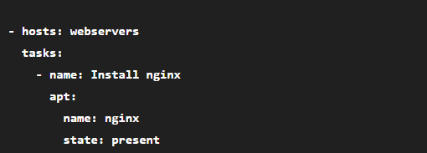
Ansible Playbooks
Definition: Playbooks are files that define a series of tasks to be executed on managed nodes.
Structure: A playbook consists of plays, tasks, and modules.

Slide 10
Modules
Overview: Modules are the building blocks of Ansible, performing specific functions.
Commonly Used Modules:
apt: For managing packages in Debian-based systems.
yum: For managing packages in Red Hat-based systems.
copy: For copying files to remote locations.
template: For processing Jinja2 templates.
Finding Modules: Use Ansible's official documentation or built-in commands to explore available modules.

Slide 11
Deep dive into Ansible Playbook

Slide 12
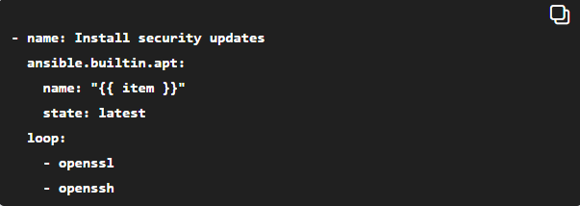
Loop
Purpose:
Loops allow you to run a task multiple times with different inputs. This reduces duplication and makes your playbook more efficient and maintainable.
How it works:
You define a list of items, and the task runs once for each item in the list.
Example:

Slide 13
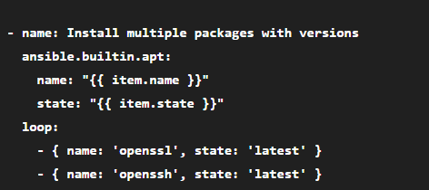
Using with_items or loop with complex data structures
Looping over dictionaries or lists of dictionaries to handle more complex scenarios.

Slide 14
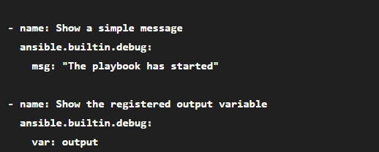
Debug
Purpose:
The debug module is used to print information during playbook execution. It’s invaluable for troubleshooting and understanding the state of variables or outputs.
How it works:
You can display simple messages or show the value of variables.
Example:

Slide 15
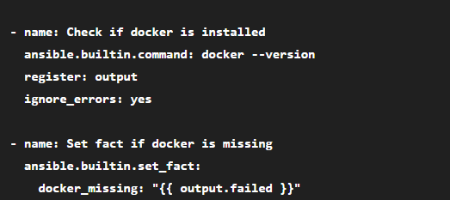
Using set_fact to define variables dynamically
This helps in setting variables based on task results or logic.

Slide 16
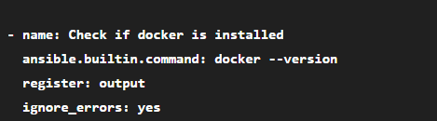
Register
Purpose:
The register keyword saves the result of a task in a variable so that you can use that information later in the playbook.
How it works:
You attach register to a task, and Ansible stores the task’s output, return code, and other metadata in the variable.
Example:
Common properties of registered variables:
output.stdout - standard output of the command
output.stderr - standard error output
output.rc - return code (0 usually means success)
output.failed - boolean indicating failure

Slide 17
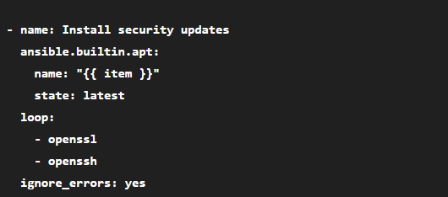
Ignore Errors
Purpose:
ignore_errors: yes allows the playbook to continue running even if the current task fails.
How it works:
By default, Ansible stops execution if a task fails. Setting ignore_errors: yes skips this behavior for that task.
Example:

Slide 18
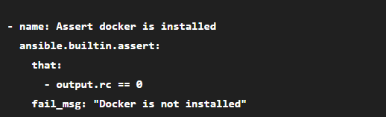
Using fail and assert modules for validations
To enforce conditions and fail the playbook if necessary.

Slide 19
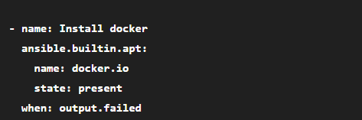
When (Conditional Execution)
Purpose:
when allows tasks to be run only if a certain condition is true. This controls the flow of the playbook based on variables, facts, or registered results.
How it works:
You provide a conditional expression after when: using Jinja2 templating.
Example:

Slide 20

Using include_tasks or import_tasks for modularity
Breaking down tasks into smaller files for better readability and reuse.

Slide 21
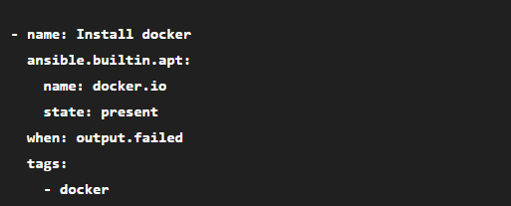
Using tags for selective execution
Tags allow you to run specific parts of your playbook without executing it fully.
You can run playbook with --tags docker to only install docker.

Slide 22
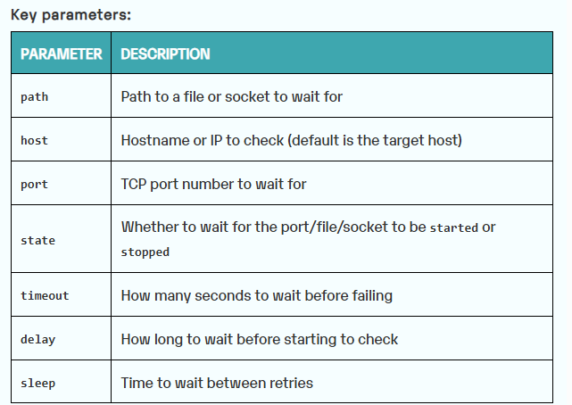
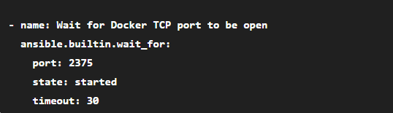
Using ansible.builtin.wait_for to wait for a service or port
Useful when you want to ensure a service is up before proceeding.

Slide 23
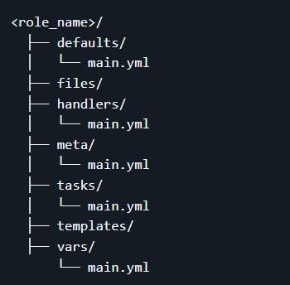
Ansible Roles
What are Roles?: Roles allow you to organize playbooks and tasks in a reusable and modular way.
Structure: A role typically includes tasks, handlers, files, templates, and variables.
Benefits: Enhances organization and promotes reusability across multiple projects.

Slide 24

Ansible Galaxy
Introduction: Ansible Galaxy is a community hub for sharing and finding Ansible roles.
Finding and Using Roles: You can search for roles on Galaxy and install them using the ansible-galaxy command.
Example Command:

Slide 25
Ansible Deployment
Demo to create a simple Ansible deployment, using Docker to simulate a deployment target.

Slide 26
Thank you!

